Slide 1
NesT DIGITAL
Hackathon
Problem Statement: Customer Credit Transfer
Submitted by TEAM BUG_INSPECTORS

Slide 2
INDEX
Validation of input file : SWIFT-MT103
Verification of input against CBS
MT to MX Conversion
Validation of output file : SWIFT-MX
Testing for Bulk inputs
Dead Letter Queue
Message performance test report
Code Quality Metrics
Vulnerability Testing (OWASP, OPENVAS and NMAP)
Deployment of solution on cloud
Additional message type MT101 -> PACS.008
Microservices Pattern

Slide 3
Validation of input file : SWIFT-MT103
Validation of input message is done against the MT 103 Network validated rules.
C1 : If field 33B is present and the currency code is different from the currency code in field 32A, field 36 must be present, otherwise field 36 is not allowed (Error code(s): D75).
C14 : 1) If field 71A contains OUR, then field 71F is not allowed and field 71G is optional (Error code(s): E13).
2) If field 71A contains SHA, then field(s) 71F is(are) optional and field 71G is not allowed (Error code(s): D50).
3) If field 71A contains BEN, then at least one occurrence of field 71F is mandatory and field 71G is not allowed (Error code(s): E15).
C18 : The currency code in the fields 71G and 32A must be the same (Error code(s): C02).

Slide 4
Verification of input against CBS
A test user has been created in the Core banking Service module.
Data extracted by the input file is sent over to this module to be compared with the predefined values of the test user.
Fields used are as follows-
Reference ID (Payment Identification)
Name of Debtor
ID of DebtoR
Amount to be transferred
Currency

Slide 5
MT to MX Conversion
STEP -1 DATA EXTRACTION
According to the defined MT103 Tags data is extracted from the given input file.
STEP -2 STORING DATA IN VARIABLES
The required parameters are stored in variables for future use.
STEP -3 CREATION OF XML FILE
Using the method of string concatenation and the values stored in above variables a XML file is created.

Slide 6
Validation of output file : SWIFT-MX
To validate the output file to be in SWIFT-MX message format
After receiving the converted file in XML format we test the data using predefined tags such as -
IntrBkSttlmAmt
Interbank Settlement Amount
Cdtr
Creditor
Dbtr
Debtor information
Opening and closing of multiple tags to ensure there is no syntax error.

Slide 7
Storing output files : Dead Letter Queue
The output files that are in corrupted MX format are orderly sent into a separate storage folder which is called DLQ.
The rest of the non-corrupted output files are stored in a different folder for future references.

Slide 8
Message performance test report :
Testing for Bulk inputs
In real world scenario multiple inputs are processed per second, to cater the needs of such monetary exchanges we need a program which can handle BULK messages
We were able to process 400 MT103 messages in a single second.
The average to process a single message was 0.015623807 seconds.

Slide 9
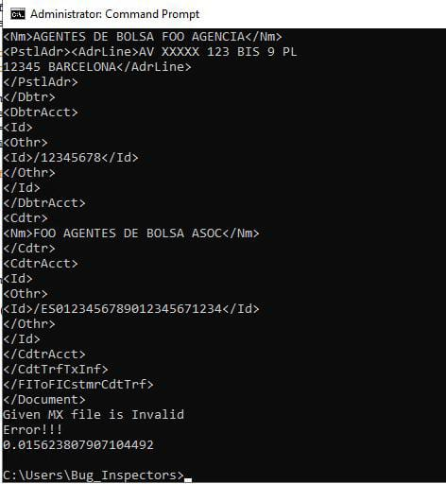
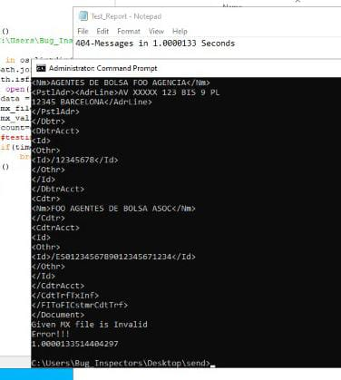
Testing for Bulk inputs

Slide 10
Code Quality Metrics
Unit testing on three modules in a single class we have received a positive report in 0.027 seconds.
We also implemented Test coverage using the coverage module in python.
The report result received initially was merely 80%
We then iterated a few lines in our code to later get a coverage of 92%.

Slide 11
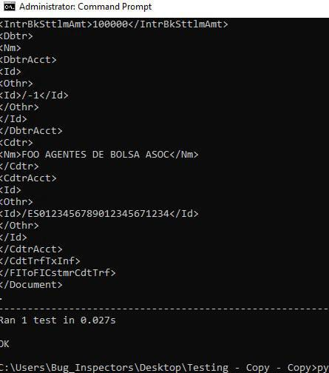
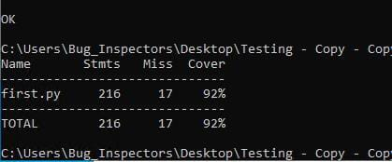
Code Quality Metrics
Here are the screenshots of the results received.

Slide 12
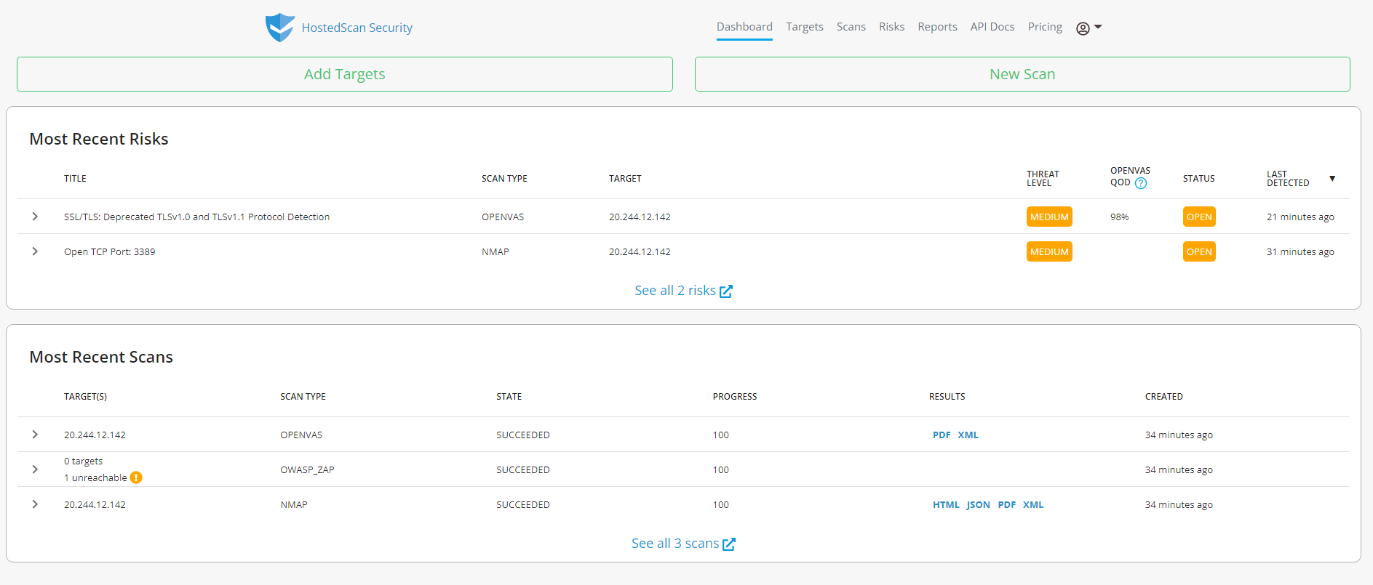
Vulnerability Testing
(OWASP, OPENVAS and NMAP)
The cloud VM was scanned for vulnerabilities using HostedScan Security for OWASP, OPENVAS and NMAP.

Slide 13
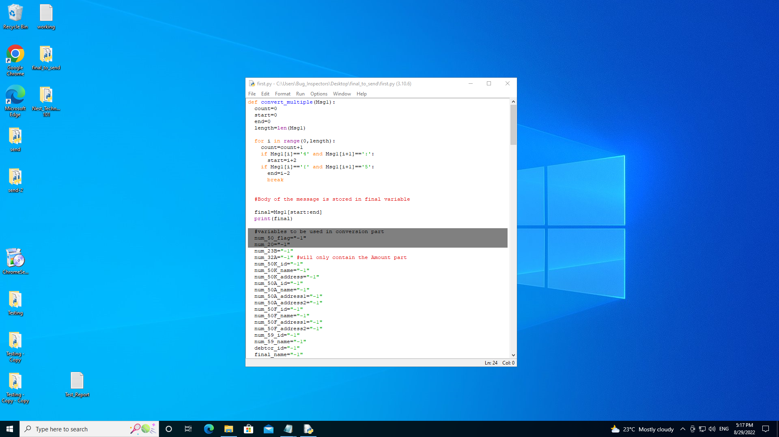
Deployment of solution on cloud
The solution was deployed on Microsoft AZURE VM on windows 10 preview operating system.

Slide 14
Additional message type MT101 -> PACS.008
We also implemented an additional message type of MT 101.
The program not only extracts the desired values from the input message but also converts it into PACS.008 message form.
The parameters are extracted by using the Standard MT 101 message format
Conversion is done again by String concatenation.

Slide 15
Microservices Pattern
The whole program is divided into three individual python modules which could be easily deployed on separate cloud based VMs.
These individual modules can be linked using APIs to act as a microservice pattern.
The components of microservices can later easily be scaled according to the requirements of an organisation or an individual.

Slide 16
Thank you
TEAM NAME : Bug_Inspectors
Team member 1 : Rishabh Srivastava
Team member 2 : Aditi Shukla
(Students of IIIT Kottayam)

